Slide 1
Dinghy
Mattias, Niklas, David, Fredrik, Jesper, Alexander, Björn

Slide 2
Requirements
(1) Direction, bearing
(1) Differential pressure across centreboard (rudder)
(1) Log/statistic
(2) Speed Over Ground
(2) Angular Velocities
(2) Position (within 1 inch)
(3) Feedback to skipper (expand)
Start line
Route
Center board pos
Sail pos
(4) Speed In Water
(4) Inclinations
(4) Wind Sensor

Slide 4
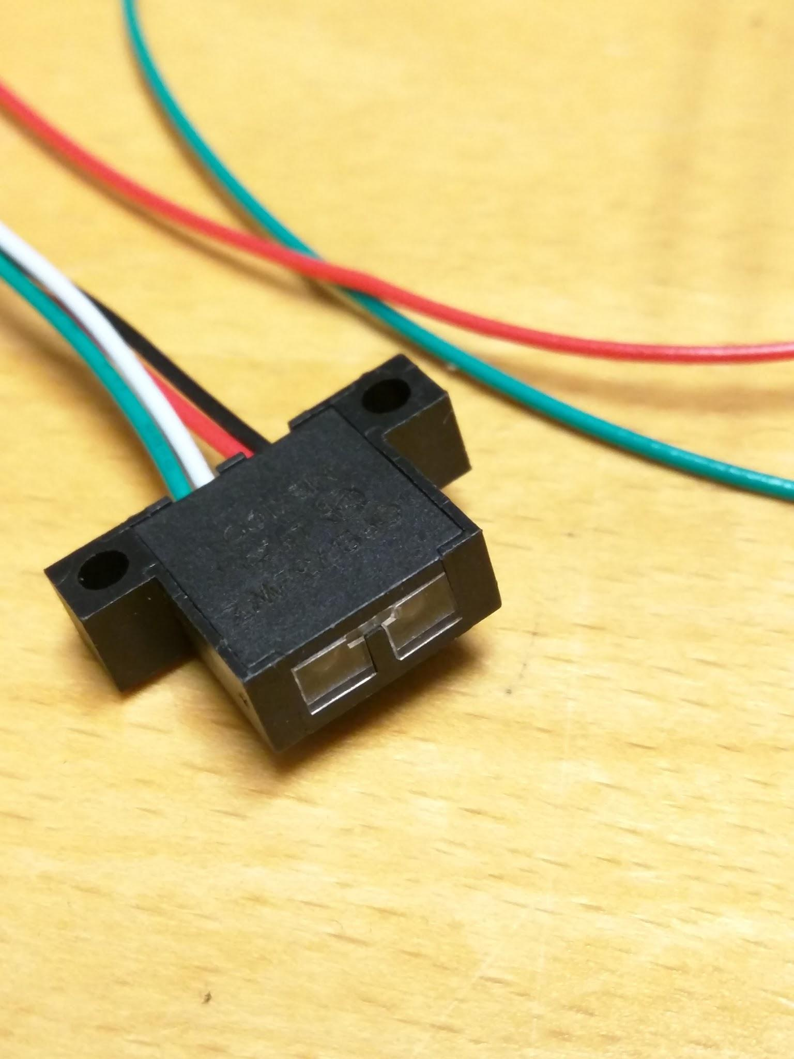
Testing of sensors
Optical switch
Changed a resistor value
Comparator circuit also work
Had to fix some solder bridges

Slide 5
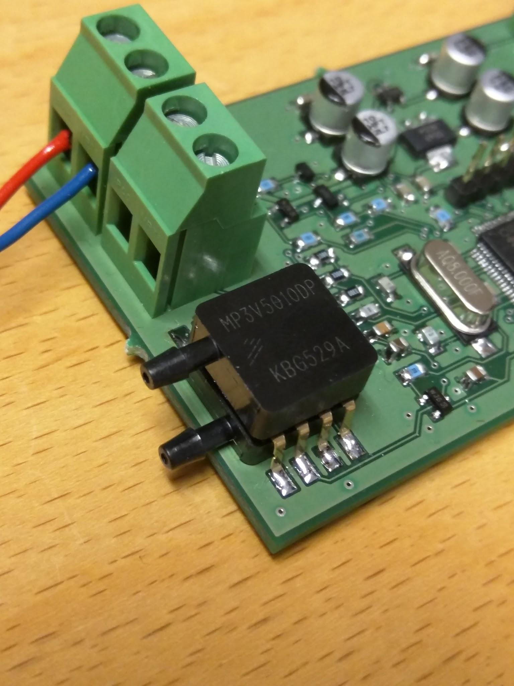
Testing of sensors
Pressure sensor
Works
0-10 kPa (P1>P2)
Output 0.1-3.1 V

Slide 6
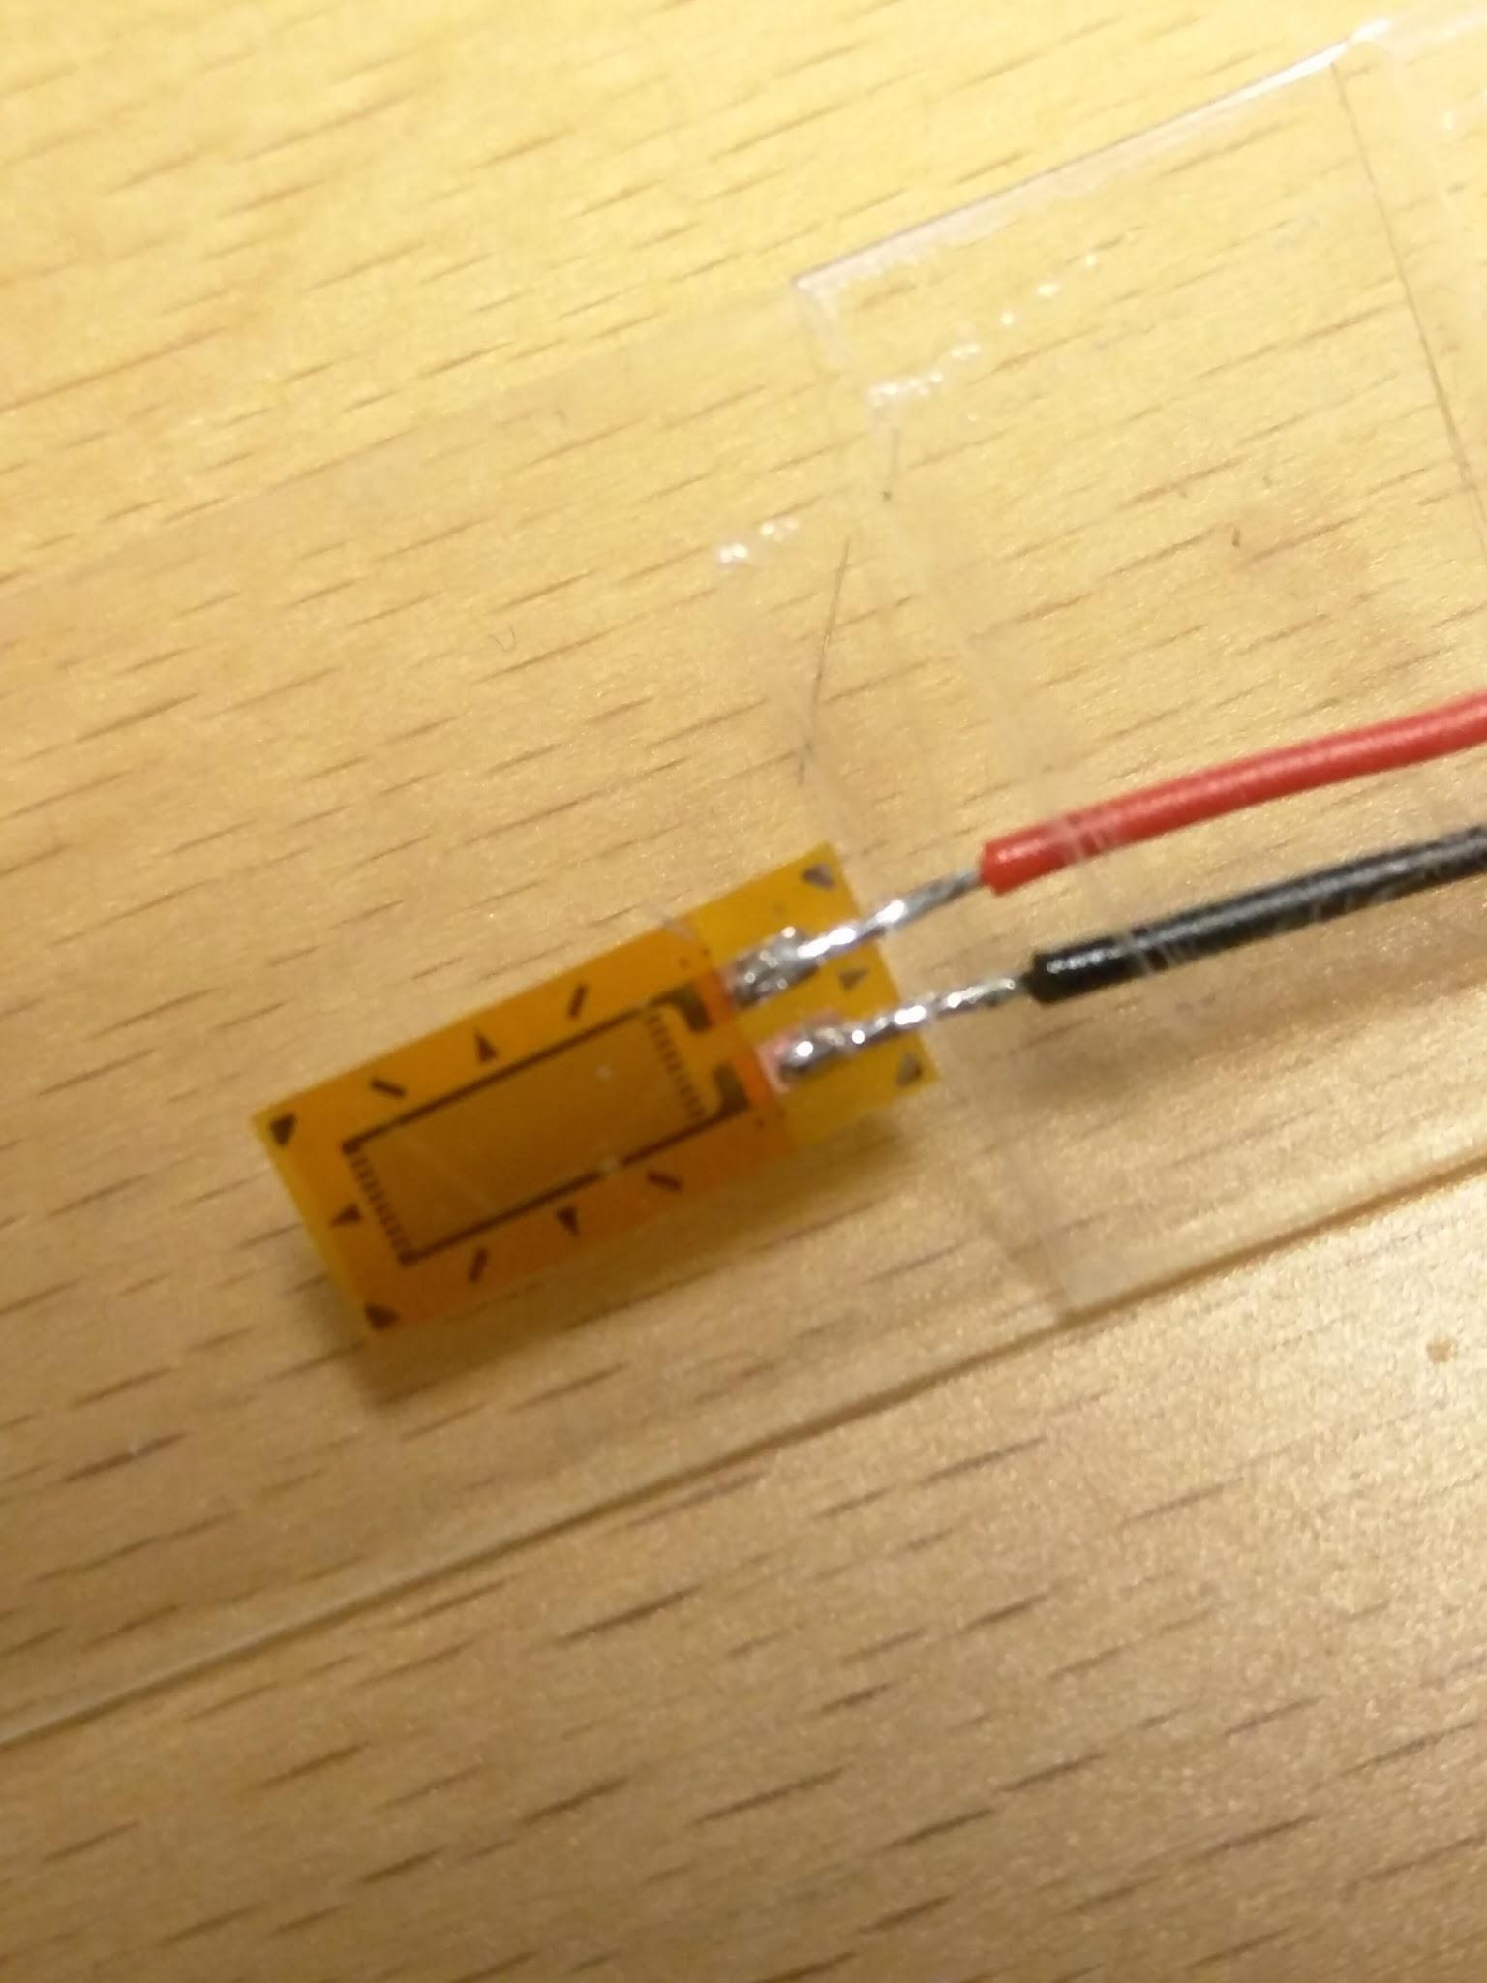
Testing of sensors
Strain gauge
Can’t measure atm too low voltage difference
Needs an amplifier

Slide 7
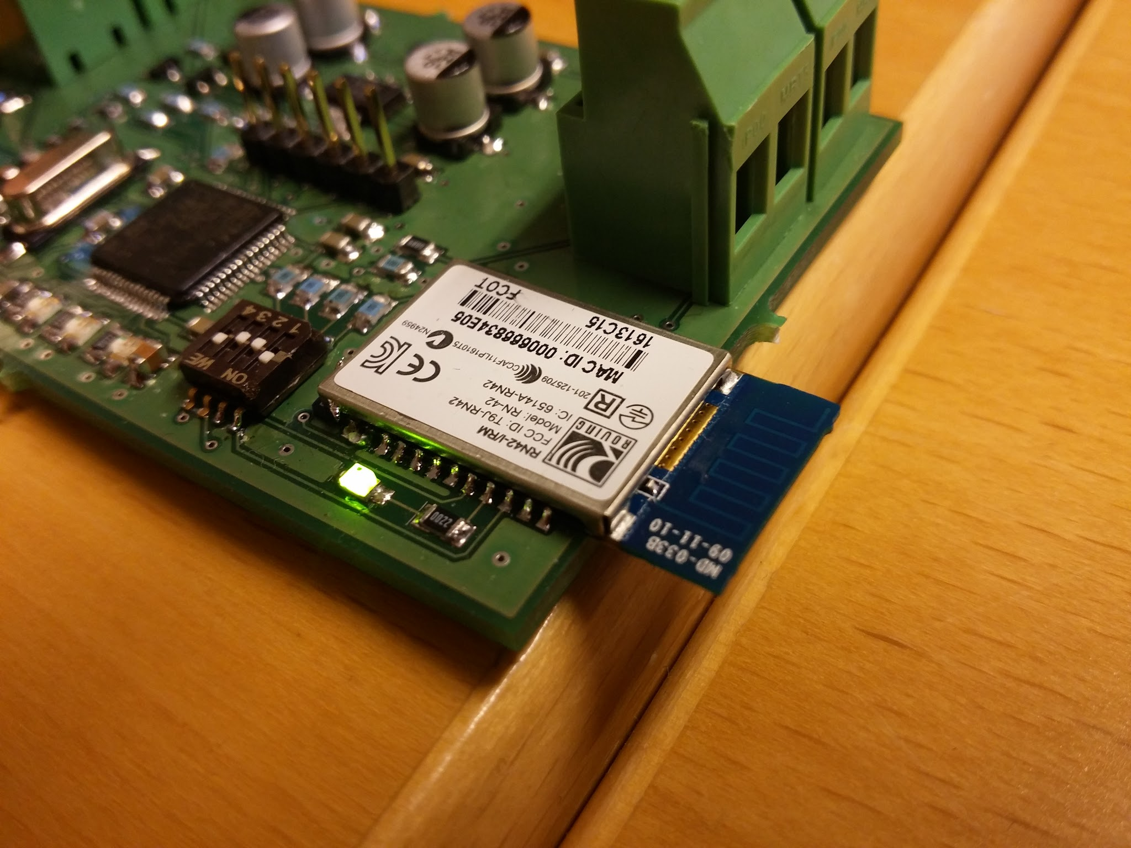
Bluetooth
Misaligned in the oven
Pads got damaged when removing the bluetooth
Solder by hand next time

Slide 8
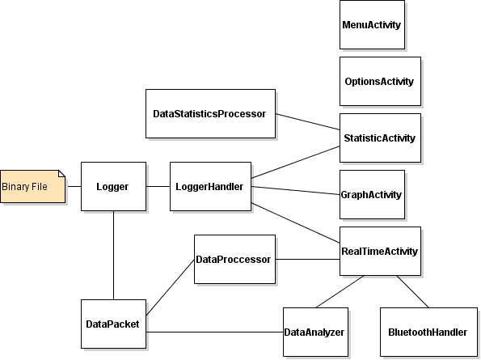
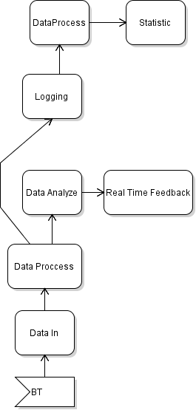
Application

Slide 9
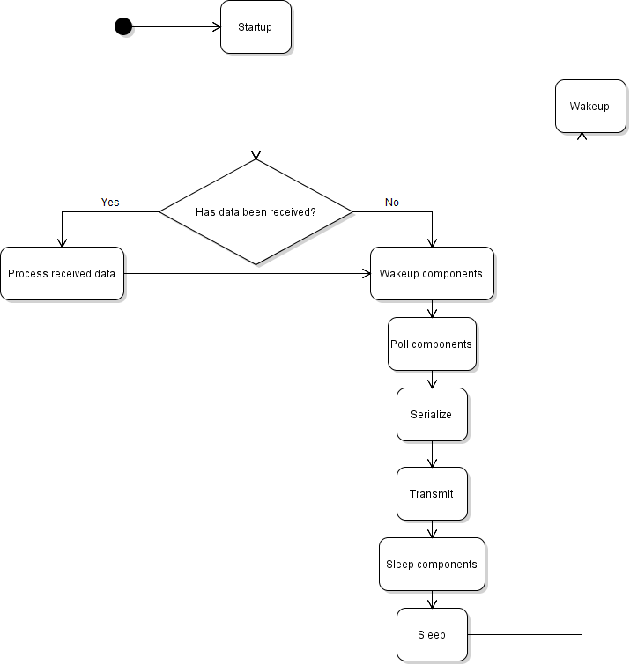
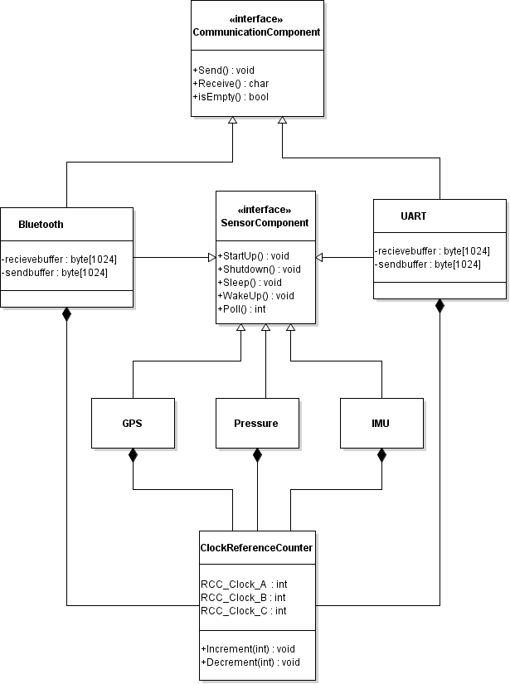
Software - embedded

Slide 10
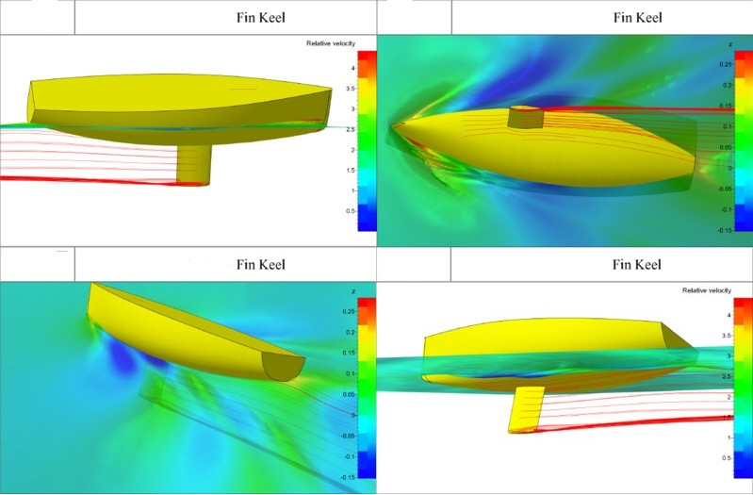
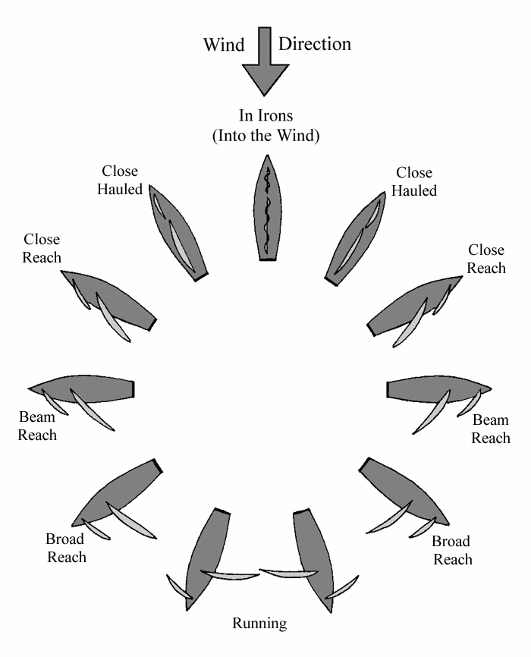
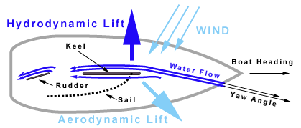
Research
Put on hold this week
Focus put on coding

